Slide 1
Discrete Mathematics and Its Application 7th edition, 2001
Kenneth H. Rosen

Slide 2
Welcome to Discrete Mathematics Spring 2018
Instructor: Niu Shao Zhang

Slide 3
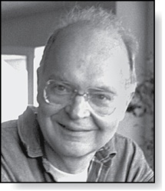
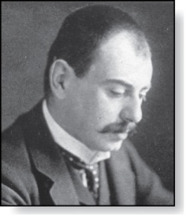
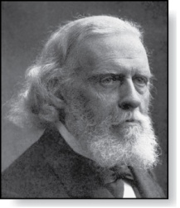
§3.2 The Growth of Functions
Donald E. Knuth
(Born 1938)
Section Summary
Big-O Notation
Big-O Estimates for Important Functions
Big-Omega and Big-Theta Notation
Edmund Landau
(1877-1938)
Paul Gustav Heinrich Bachmann
(1837-1920)

Slide 4
§3.2 The Growth of Functions
In both computer science and in mathematics, there are many times when we care about how fast a function grows.
In computer science, we want to understand how quickly an algorithm can solve a problem as the size of the input grows.
We can compare the efficiency of two different algorithms for solving the same problem. （用于比较两个不同算法在解决同意问题的效率）
We can also determine whether it is practical to use a particular algorithm as the input grows. （确定在输入增长时使用该算法是否可行）

Slide 5
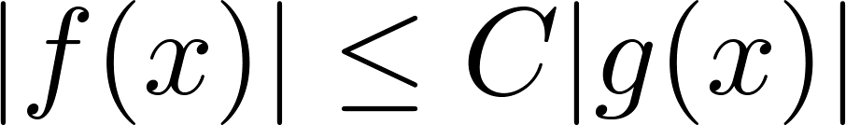
Big-O Notation
Definition: Let f and g be functions from the set of integers or the set of real numbers to the set of real numbers. We say that f(x) is O(g(x)) if there are constants C and k such that
whenever x > k. (illustration on next slide)
This is read as “f(x) is big-O of g(x)” or “g asymptotically dominates f.”（g 渐近控制f.）
The constants C and k are called witnesses（凭证） to the relationship f(x) is O(g(x)). Only one pair of witnesses is needed.

Slide 6
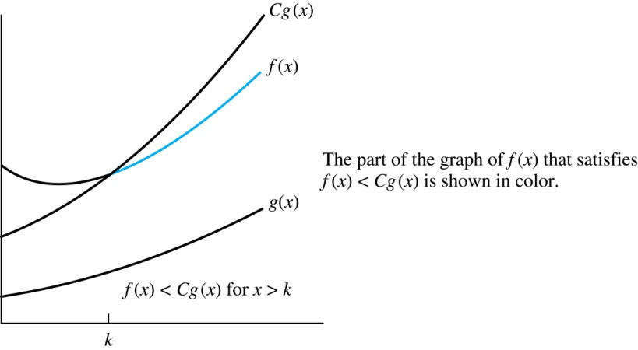
Illustration of Big-O Notation
f(x) is O(g(x))

Slide 7

Some Important Points about Big-O Notation
If one pair of witnesses(C and k) is found, then there are infinitely many pairs. We can always make the k or the C larger and still maintain the inequality
Any pair C ̍ and k̍ where C < C̍ and k < k ̍ is also a pair of witnesses since whenever x > k̍ > k.

Slide 8
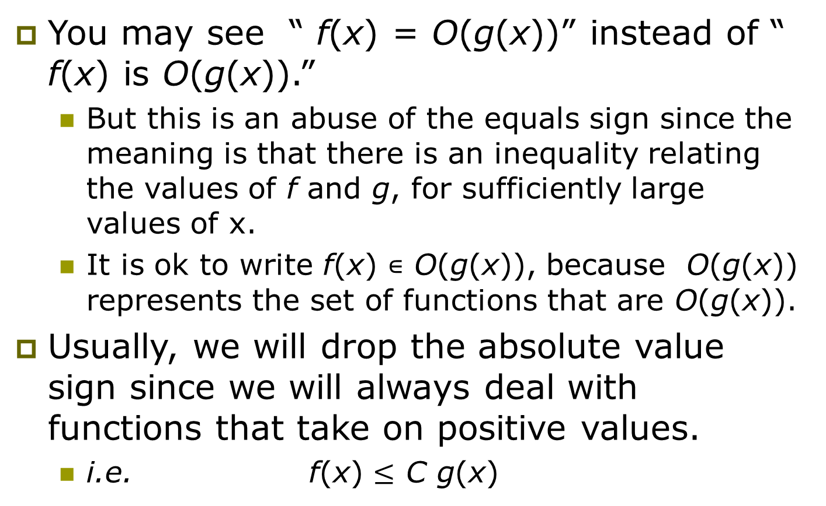
Some Important Points about Big-O Notation
You may see “ f(x) = O(g(x))” instead of “ f(x) is O(g(x)).”
But this is an abuse of the equals sign since the meaning is that there is an inequality relating the values of f and g, for sufficiently large values of x.
It is ok to write f(x) ∊ O(g(x)), because O(g(x)) represents the set of functions that are O(g(x)).
Usually, we will drop the absolute value sign since we will always deal with functions that take on positive values.
i.e. f(x) $≤$ C g(x)

Slide 9
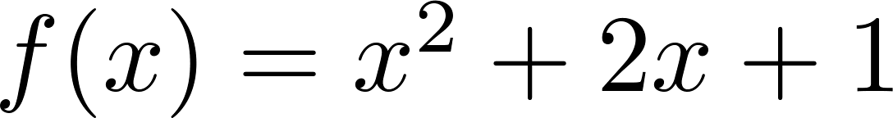
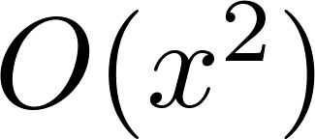
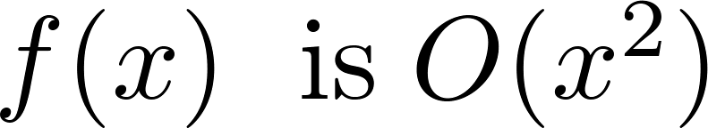
Using the Definition of Big-O Notation
Example: Show that is .
Solution: Since when x > 1, x < x² and 1 < x²
Can take C = 4 and k = 1 as witnesses to show that
(see graph on next slide)
Alternatively, when x > 2, we have 2x ≤ x² and
1 < x². Hence, when x > 2.
Can take C = 3 and k = 2 as witnesses instead.
（满足条件的C，k 不止一对！）

Slide 10
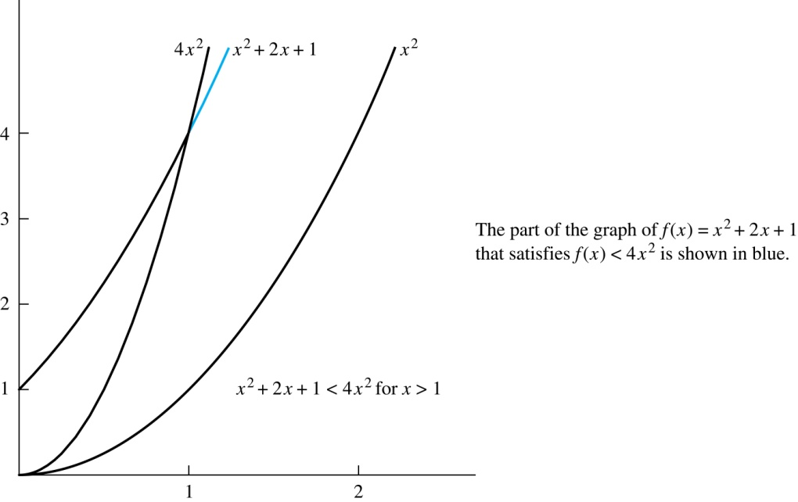
Illustration of Big-O Notation
is

Slide 11
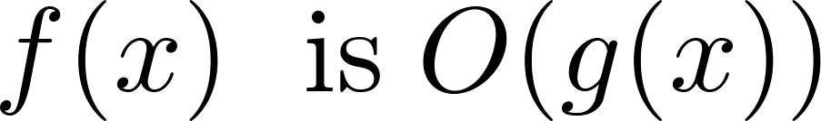
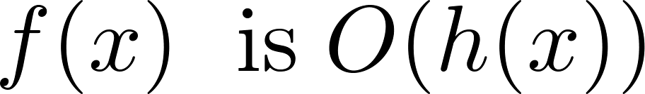
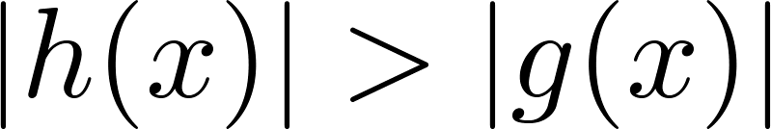
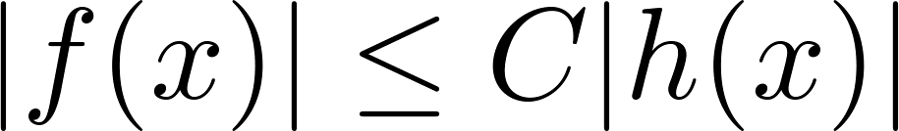
Big-O Notation
If and h(x) is larger than g(x) for all positive real numbers, then .
Note that if for x > k and if
for all x, then if x > k. Hence, .
For many applications, the goal is to select the function g(x) in O(g(x)) as small as possible (up to multiplication by a constant, of course).
在满足 的g(x)中，应该取最小的g(x).

Slide 12
Using the Definition of Big-O Notation
Example: Show that 7x² is O(x³).
Solution: When x > 7, 7x² < x³. Take C =1 and k = 7 as witnesses to establish that 7x² is O(x³).
Would C = 7 and k = 1 work?
7x² is O(x²)

Slide 13
Using the Definition of Big-O Notation
Example: Show that n² is not O(n).
Solution: Suppose there are constants C and k for which n² ≤ Cn, whenever n > k. Then (by dividing both sides of n² ≤ Cn) by n, then n ≤ C must hold for all n > k. A contradiction!

Slide 14
“Big-O” Proof Examples
Show that 30n+8 is O(n).
Show ∃c,k: ∀n>k: 30n+8 ≤ cn.
Let c=31, k=8. Assume n>k=8. Then cn = 31n = 30n + n > 30n+8, so 30n+8 < cn.
Show that n²+1 is O(n²).
Show ∃c,k: ∀n>k: n²+1 ≤ cn².
Let c=2, k=1. Assume n>1. Then cn² = 2n² = n²+n² > n²+1, or n²+1< cn².

Slide 15

Big-O Estimates for Polynomials
Example: Let
where are real numbers with a_{n} ≠0.
Then f(x) is O(x^{n}).
Proof: |f(x)|=|a_{n}x^{n} + a_{n-1} x^{n-1} + ∙∙∙ + a₁x¹ + a₁|
≤ |a_{n}|x^{n} + |a_{n-1}| x^{n-1} + ∙∙∙ + |a₁|x¹ + |a₁|
= x^{n} (|a_{n}| + |a_{n-1}| /x + ∙∙∙ + |a₁|/x^{n-1} + |a₁|/ x^{n})
≤ x^{n} (|a_{n}| + |a_{n-1}| + ∙∙∙ + |a₁|+ |a₁|)
Take C = |a_{n}| + |a_{n-1}| + ∙∙∙ + |a₁|+ |a₁| and k = 1. Then f(x) is O(x^{n}).
The leading term a_{n}x^{n} of a polynomial dominates its growth.
Uses triangle inequality, an exercise in Section 1.8.
Assuming x > 1

Slide 16
Big-O Estimates for some Important Functions
Example: Use big-O notation to estimate the sum of the first n positive integers.
Solution:

Slide 17
Big-O Estimates for some Important Functions
Example: Use big-O notation to estimate the factorial function
Solution:

Slide 18
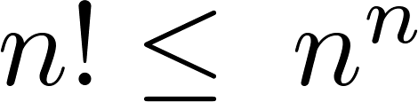
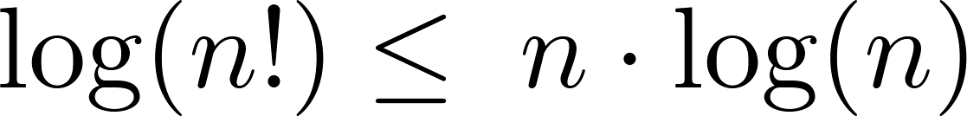
Big-O Estimates for some Important Functions
Example: Use big-O notation to estimate log n!
Solution: Given that (previous slide)
then
Hence, log(n!) is O(n∙log(n)) taking C = 1 and k = 1.

Slide 19
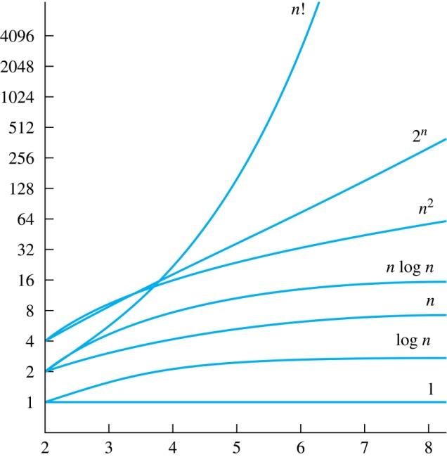
Display of Growth of Functions
Note the difference in behavior of functions as n gets larger

Slide 20
Orders of Growth
If g(x) is faster growing than f(x) , then g(x) always eventually becomes larger than f(x) in the limit (for large enough values of x).
Useful in engineering for showing that one design scales better or worse than another.

Slide 21

little-o of g
In calculus
If
$\lim_{x→∞}\frac{f(x)}{g(x)}=0$
Then
f is o(g) (called little-o of g)

Slide 22
Theorem
If f is o(g) then f is O(g).
Proof:
by definition of limit as x goes to infinity, f(n)/g(n) gets arbitrarily small.
That is for any ε >0, there must be an real number M such that when x > M,
| f(x)/g(x) | < ε .
Hence, choose C = ε and k = M.
Q. E. D.

Slide 23
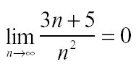
Example
3n + 5 is O(n²)
Proof: It's easy to show
using the theory of limits.
Hence 3n + 5 is o(n²) and so it is O(n²).
Q. E. D.

Slide 24
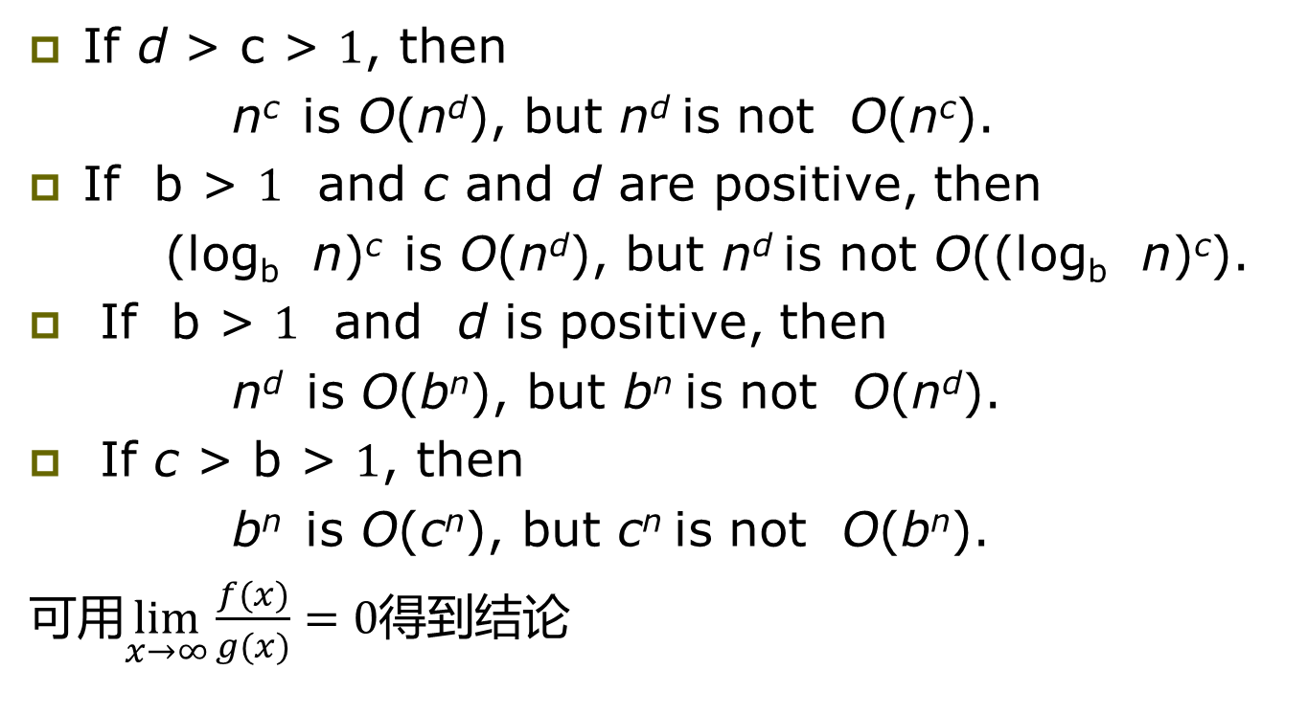
Useful Big-O Estimates Involving Logarithms, Powers, and Exponents
If d > c > 1, then
n^{c} is O(n^{d}), but n^{d} is not O(n^{c}).
If b > 1 and c and d are positive, then
(log_{b} n)^{c} is O(n^{d}), but n^{d} is not O((log_{b} n)^{c}).
If b > 1 and d is positive, then
n^{d} is O(b^{n}), but b^{n} is not O(n^{d}).
If c > b > 1, then
b^{n} is O(c^{n}), but c^{n} is not O(b^{n}).
可用$\lim_{x→∞}\frac{f(x)}{g(x)}=0$得到结论

Slide 25
Combinations of Functions
Theorem 2
If f₁ (x) is O(g₁(x)) and f₂ (x) is O(g₂(x)) then
( f₁ + f₂ )(x) is O(max(g₁(x), g₂(x))).
Corollary 1
If f₁ (x) and f₂ (x) are both O(g(x)) then
( f₁ + f₂ )(x) is O(g(x)).
Theorem 3
If f₁ (x) is O(g₁(x)) and f₂ (x) is O(g₂(x)) then
( f₁(x)f₂(x))(x) is O(g₁(x)g₂(x)).

Slide 26
Combinations of Functions
If f₁ (x) is O(g₁(x)) and f₂ (x) is O(g₂(x)) then
( f₁ + f₂ )(x) is O(max(|g₁(x) |,|g₂(x) |)).
By the definition of big-O notation, there are constants C₁,C₂ ,k₁,k₂ such that
| f₁ (x) ≤ C₁|g₁(x) | when x > k₁ and f₂ (x) ≤ C₂|g₂(x) |
when x > k₂ .
|( f₁ + f₂ )(x)| = |f₁(x) + f₂(x)|
≤ |f₁ (x)| + |f₂ (x)| by the triangle inequality |a + b| ≤ |a| + |b|
|f₁ (x)| + |f₂ (x)| ≤ C₁|g₁(x) | + C₂|g₂(x) |
≤ C₁|g(x) | + C₂|g(x) | where g(x) = max(|g₁(x)|,|g₂(x)|)
= (C₁ + C₂) |g(x)|
= C|g(x)| where C = C₁ + C₂
Therefore |( f₁ + f₂ )(x)| ≤ C|g(x)| whenever x > k, where k = max(k₁,k₂).

Slide 27
Proof of f₁f₂ is O(g₁g₂)
We use the inequality
if 0 < a < b and 0 < c < d then ac < bd
to conclude that
f₁(x)f₂(x) < c₁c₂g₁(x)g₂(x)
as long as k > max{k₁, k₂} so that both inequalities 1 and 2. hold at the same time.
Therefore, choose
c₃ = c₁c₂
and
k₃ = max{k₁, k₂}.
Q. E. D.

Slide 28
Example
Find the complexity class of the function
(nn!+ 3^{n+2} + 3n¹⁰⁰ )(n^{n} + n2^{n} )
Solution:
This means to simplify the expression.
Throw out stuff which you know doesn't grow as fast. And at last:
nn! n^{n}

Slide 29
Ordering Functions by Order of Growth
Put the functions below in order so that each function is big-O of the next function on the list.
f₁(n) = (1.5)^{n}
f₂(n) = 8n³+17n² +111
f₃(n) = (log n )²
f₄(n) = 2^{n}
f₅(n) = log (log n)
f₆(n) = n² (log n)³
f₇(n) = 2^{n} (n² +1)
f₈(n) = n³+ n(log n)²
f₉(n) = 10000
f₁₀(n) = n!
可利用极限形式比较
We solve this exercise by successively finding the function that grows slowest among all those left on the list.
f₉(n) = 10000 (constant, does not increase with n)
f₅(n) = log (log n) (grows slowest of all the others)
f₃(n) = (log n )² (grows next slowest)
f₆(n) = n² (log n)³ (next largest, (log n)³ factor smaller than any power of n)
f₂(n) = 8n³+17n² +111 (tied with the one below)
f₈(n) = n³+ n(log n)² (tied with the one above)
f₁(n) = (1.5)^{n} (next largest, an exponential function)
f₄(n) = 2^{n} (grows faster than one above since 2 > 1.5)
f₇(n) = 2^{n} (n² +1) (grows faster than above because of the n² +1 factor)
f₁₀(n) = 3^{n} ( n! grows faster than c^{n} for every c)

Slide 30
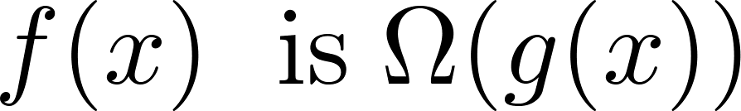
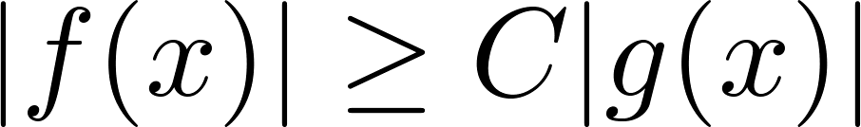
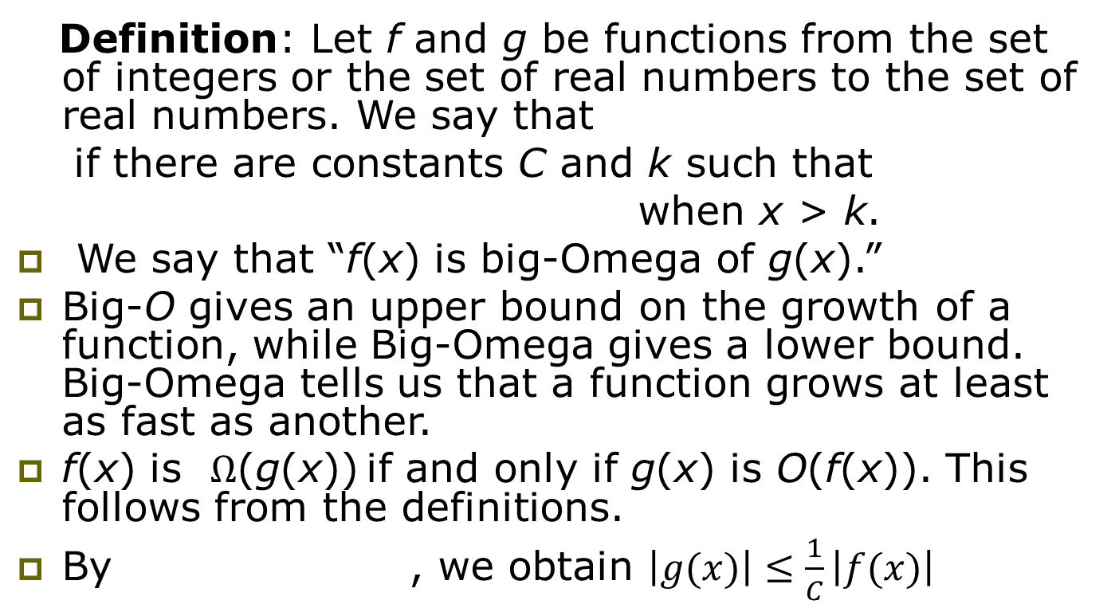
Big-Omega Notation
Ω is the upper case version of the lower case Greek letter ω.
Definition: Let f and g be functions from the set of integers or the set of real numbers to the set of real numbers. We say that
if there are constants C and k such that
when x > k.
We say that “f(x) is big-Omega of g(x).”
Big-O gives an upper bound on the growth of a function, while Big-Omega gives a lower bound. Big-Omega tells us that a function grows at least as fast as another.
f(x) is Ω(g(x)) if and only if g(x) is O(f(x)). This follows from the definitions.
By , we obtain $\left|g(x)\right|≤\frac{1}{C}\left|f(x)\right|$

Slide 31
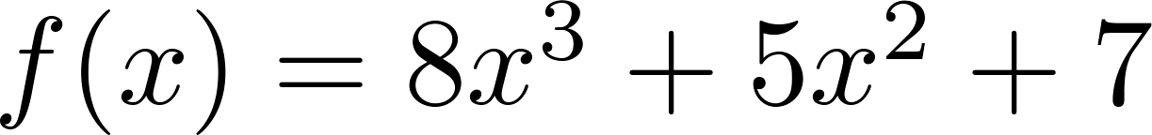
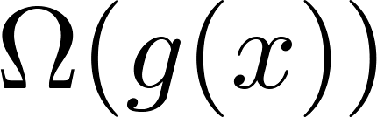
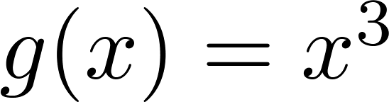
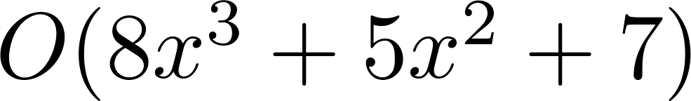
Big-Omega Notation
Example: Show that is where .
Solution: for all positive real numbers x.
Is it also the case that is
?

Slide 32
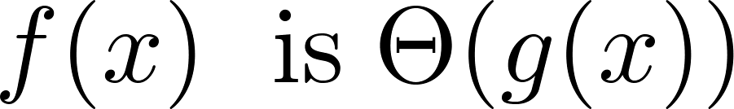
Big-Theta Notation
Θ is the upper case version of the lower case Greek letter θ.
Definition: Let f and g be functions from the set of integers or the set of real numbers to the set of real numbers. The function if and .
We say that “f is big-Theta of g(x)” and also that “f(x) is of order g(x)” and also that “f(x) and g(x) are of the same order.”
if and only if there exists constants C₁ , C₂ and k such that
|C₁g(x)|≤|f(x)|≤|C₂g(x)|
if x > k. This follows from the definitions of big-O and big-Omega.

Slide 33
Big Theta Notation
Example: Show that the sum of the first n positive integers is Θ(n²).
Solution: Let f(n) = 1 + 2 + ∙∙∙ + n.
We have already shown that f(n) is O(n²).
To show that f(n) is Ω(n²), we need a positive constant C such that f(n) > Cn² for sufficiently large n. Summing only the terms greater than n/2 we obtain the inequality
1 + 2 + ∙∙∙ + n ≥ ⌈ n/2⌉ + (⌈ n/2⌉ + 1) + ∙∙∙ + n
≥ ⌈ n/2⌉ + ⌈ n/2⌉ + ∙∙∙ + ⌈ n/2⌉
= (n − ⌈ n/2⌉ + 1 ) ⌈ n/2⌉
≥ (n/2)(n/2) = n²/4
Taking C = ¼, f(n) > Cn² for all positive integers n. Hence, f(n) is Ω(n²), and we can conclude that f(n) is Θ(n²).

Slide 34
Θ example
Determine whether:
Quick solution:

Slide 35
Big-Theta Notation
Example: Sh0w that f(x) = 3x² + 8x log x is Θ(x²).
Solution:
3x² + 8x log x ≤ 11x² for x > 1, since 0 ≤ 8x log x ≤ 8x² .
Hence, 3x² + 8x log x is O(x²).
x² is clearly O(3x² + 8x log x)
Hence, 3x² + 8x log x is Θ(x²).

Slide 36
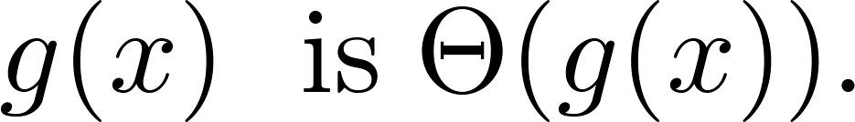
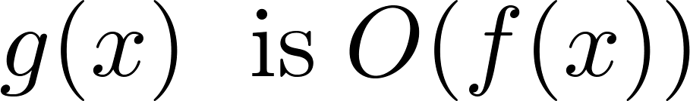
Big-Theta Notation
When it must also be the case that
Note that if and only if it is the case that and
.
Sometimes writers are careless and write as if big-O notation has the same meaning as big-Theta.

Slide 37

Big-Theta
In calculus
If
$\lim_{x→∞}\frac{f(x)}{g(x)}=C≠0$
Then

Slide 38
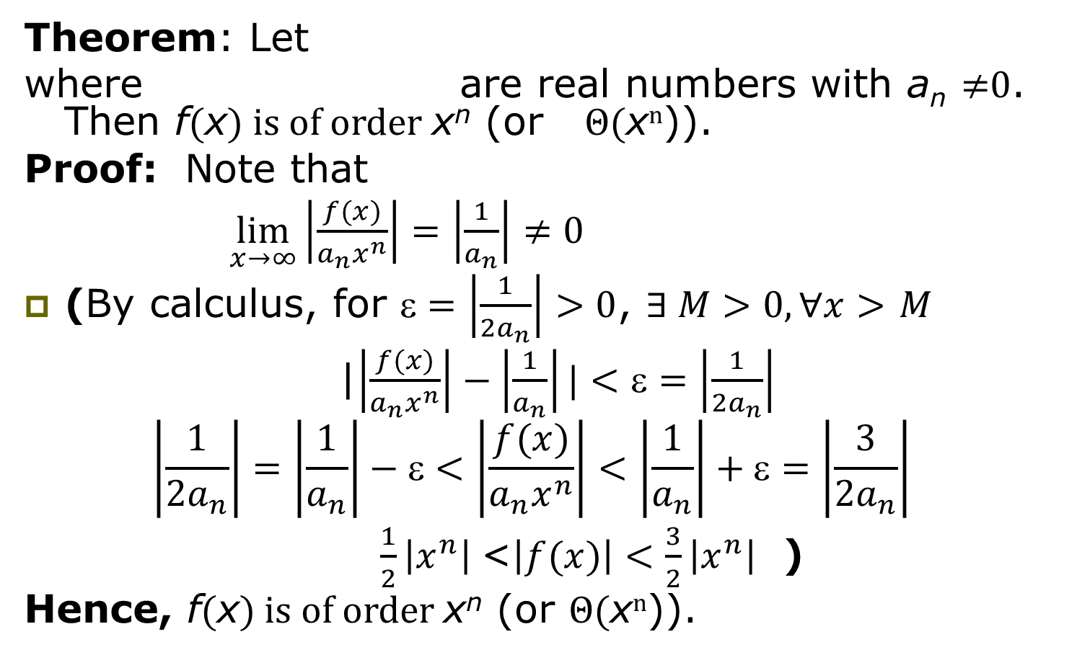
Big-Theta Estimates for Polynomials
Theorem: Let
where are real numbers with a_{n} ≠0. Then f(x) is of order x^{n} (or Θ(x^{n})).
Proof: Note that
$\lim_{x→∞}\left|\frac{f(x)}{a_{n}x^{n}}\right|=\left|\frac{1}{a_{n}}\right|≠0$
(By calculus, for $\text{e}=\left|\frac{1}{{2a}_{n}}\right|>0$, $∃ M>0, ∀x>$ $M$
|$\left|\frac{f(x)}{a_{n}x^{n}}\right|−\left|\frac{1}{a_{n}}\right||<\text{e}=\left|\frac{1}{{2a}_{n}}\right|$
$$\left|\frac{1}{{2a}_{n}}\right|=\left|\frac{1}{a_{n}}\right|−\text{e}<\left|\frac{f(x)}{a_{n}x^{n}}\right|<\left|\frac{1}{a_{n}}\right|+\text{e}=\left|\frac{3}{{2a}_{n}}\right|$$
$\frac{1}{2}\left|x^{n}\right| \text{<}\left|f(x)\right|<\frac{3}{2}\left|x^{n}\right|$ )
Hence, f(x) is of order x^{n} (or Θ(x^{n})).

Slide 39
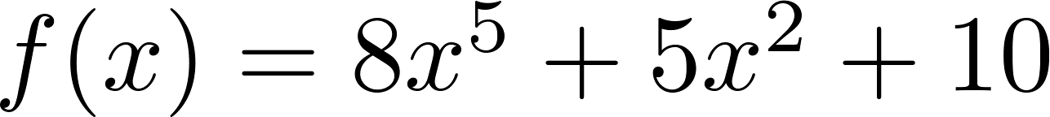
Big-Theta Estimates for Polynomials
Example:
The polynomial is order of x⁵ (or Θ(x⁵)).
The polynomial is order of x¹⁹⁹ (or Θ(x¹⁹⁹) ).

Slide 40
Homework
§3.2
34,72

